Slide 1

OLD BOOK STORE

Slide 2
ABOUT US
We are the giving the platform to users to sell and buy the old books.
This web applications is used to buy and sell second hand books. User can send or post their old books over our website. Through a web browser the customer can search for a book by its title or author later can add to a shopping cart and finally purchase a books.
The online book store application enables vendor to setup online book store, customer to browse through a book and a system administrator and reject request for a new books.

Slide 3
OBJECTIVE
The main objective of this project is to provide a essence of online book store via a simple and powerful medium,.
The project has been designed to simulate the working of an actual online old book store.

Slide 4
PROBLEM STATEMENT
The Purpose of website is establish fact that internet users are increasing today. Today one of main purpose of the website is to facilitate the offline customer online because customers cannot spend their precious time in markets trying to find the best deals of old books .
Our priority will be our customers and their requirements for books.
We will putting the efforts to provide the right choice to the people when they buy or sell the books online.

Slide 5
MODULES OF PROJECTS
CUSTOMERS:-
Registration
login
View books details
buy and add to cart
logout

Slide 6
modules of project
ADMIN:-
login
add or delete books
create categories
check product id
logout

Slide 7
REQUIREMENT
User Interfaces
The user interface for system shall be compatible to any type of web browser such as Mozilla Firefox, Google Chrome, and safari..
HARDWARE REQUIREMENT:
2GB RAM
SOFTWARE REQUIREMENT:
MERN

Slide 8
FRONT END AND BACK END
React.js : a client-side javascript framework.
Express.js: node.js web framework .
Node.js: the premier js framework.
MongoDB: backend or document database.

Slide 9
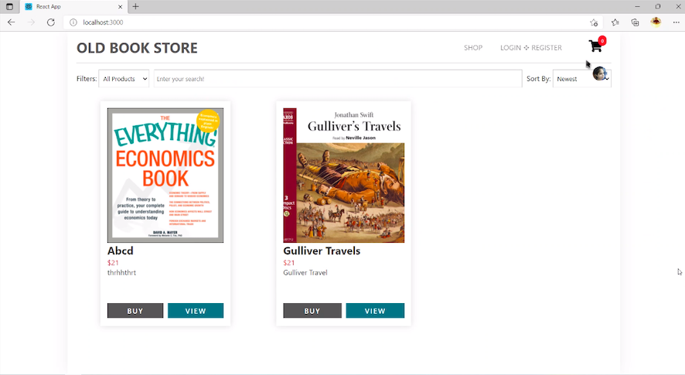
HOME PAGE

Slide 10
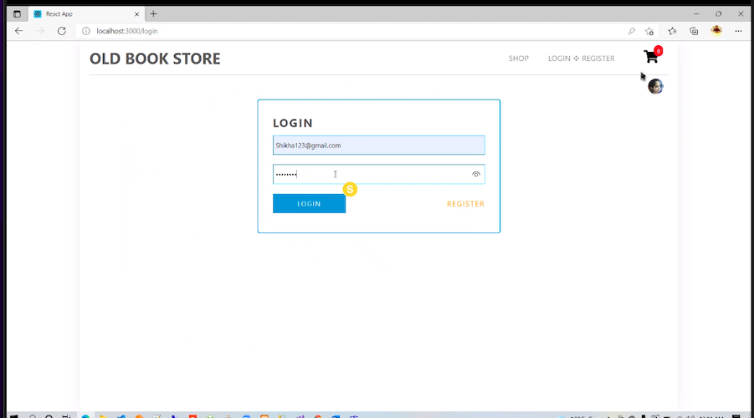
CUSTOMER & LOGIN LOGIN PAGE

Slide 11
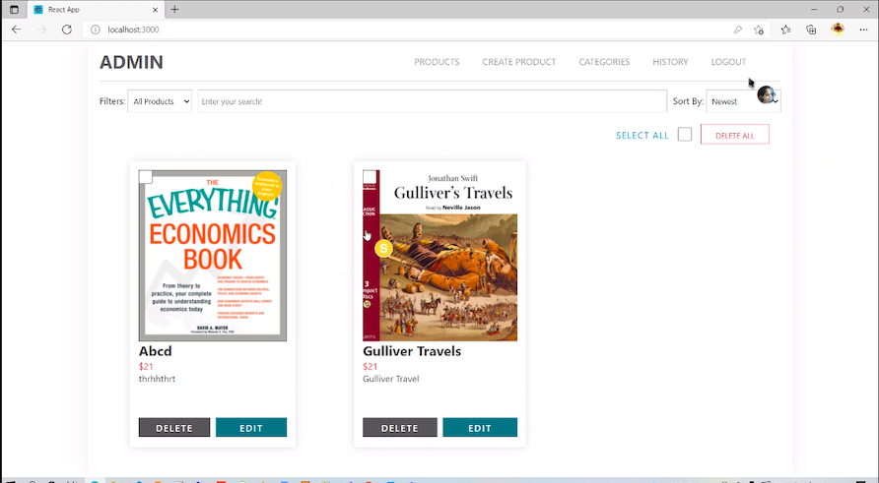
ADMIN LOGIN PAGE

Slide 12
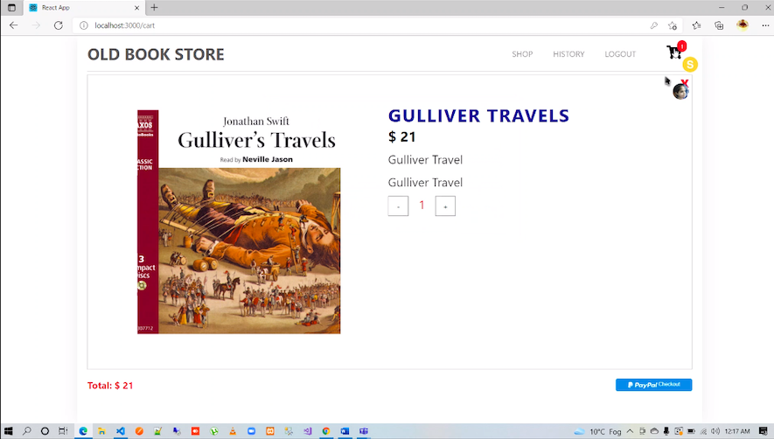
CART

Slide 13
FUTURE SCOPE
We will include more functionality as per the user requirements.
We want to improved our homepage , as it is the main thing which attract all users.
Not a single website is ever consider as complete forever firstly because there is always something requirements also growing day by day.

Slide 14
TEAM MEMBERS
SHIKHA CHAUDHARY
SIMRAN SAIFI
SHREYA GAUR
ARSHI GAUR

Slide 15
CONCLUSION
Online old book store is an online web application where the customer can purchase old books online. Through a web browser customer can search for a book by its title or author, later can add to the shopping cart and finally purchase the books.

Slide 16

THANK YOU…

